Slide 1
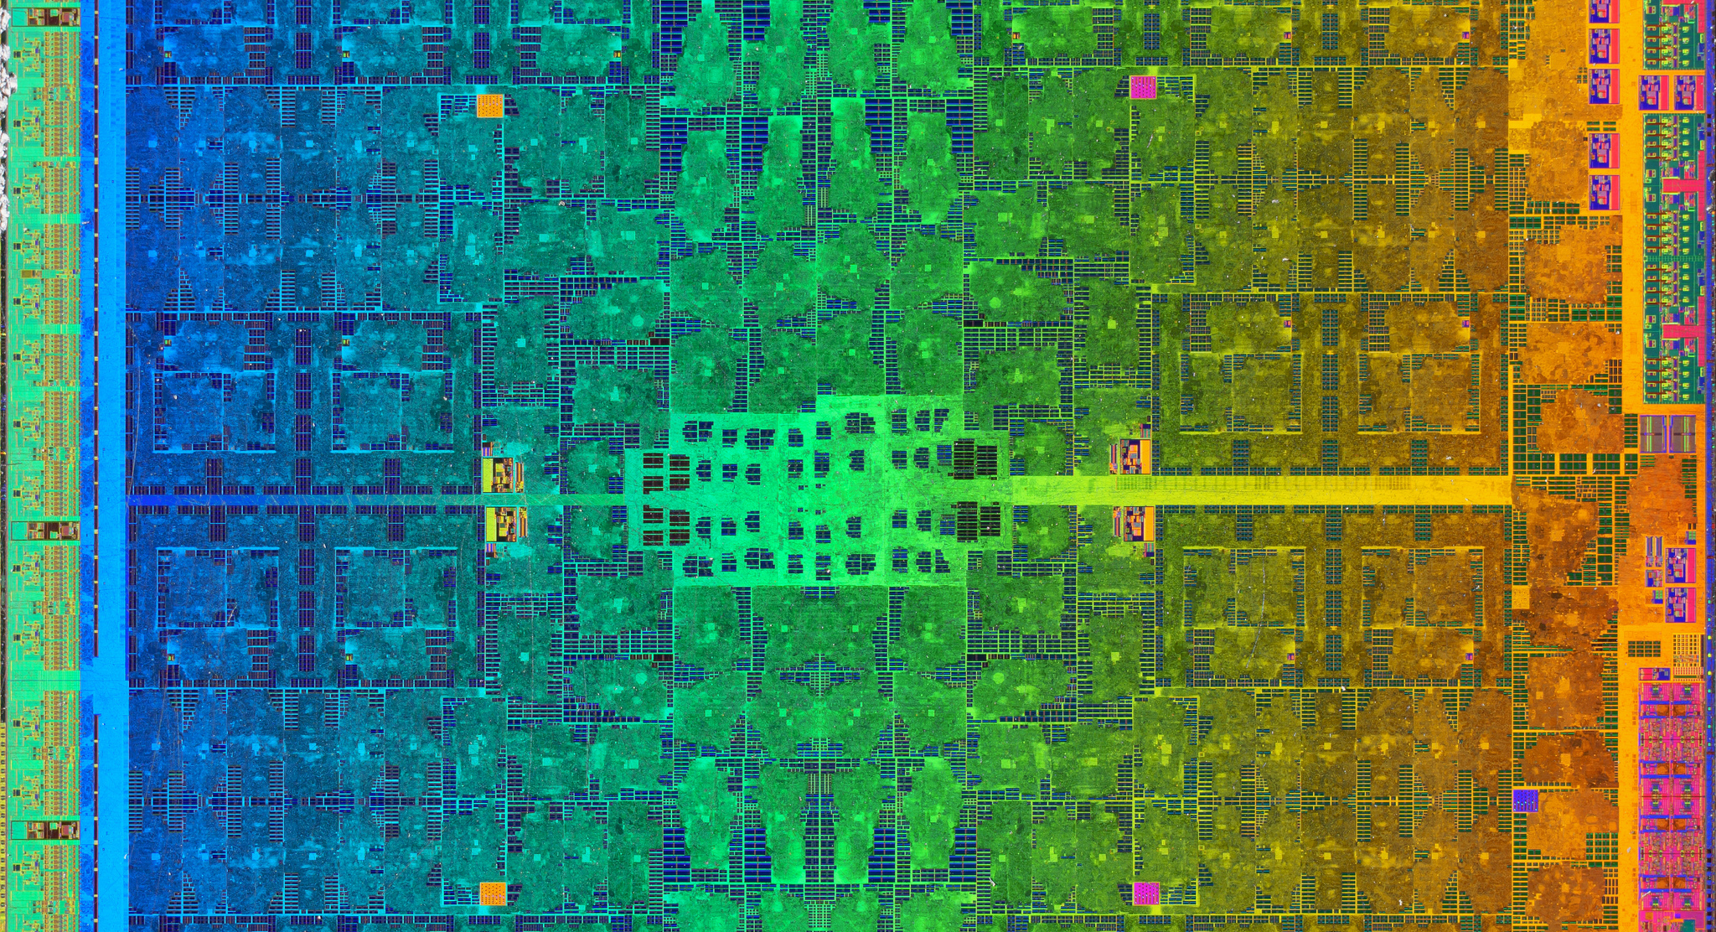
Xilinx Matrix Multiplication Systolic Array
ELEC 522
Project #2
Karan Venaik

Slide 2
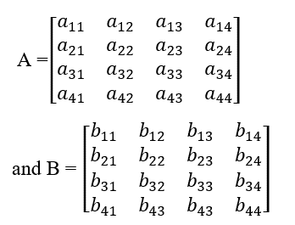
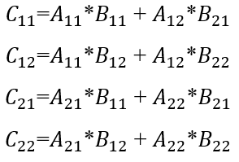
What Are We Doing Here?
Multiply two 4x4 matrices using a systolic array
X

Slide 3
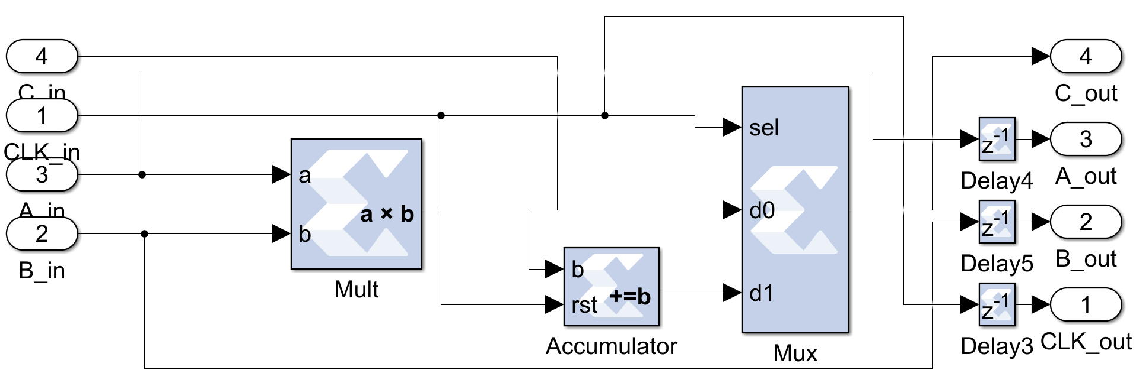
Multiply-Accumulate/Compute Block
Aim is to be systolic – pass all data through current block into next block.
Multiply elements as described in lecture.
Accumulate elements until reset signal is encountered.
Forward current accumulator output when coefficient is calculated or previous block output.
Pass on all input signals with singular delay – unload LEFT (allows unloading as soon as C_11 is generated).
Scalability – Can increase size of matrix, can chain numerous multipliers to generate product (A x B x C x D x E x … = Y).

Slide 4
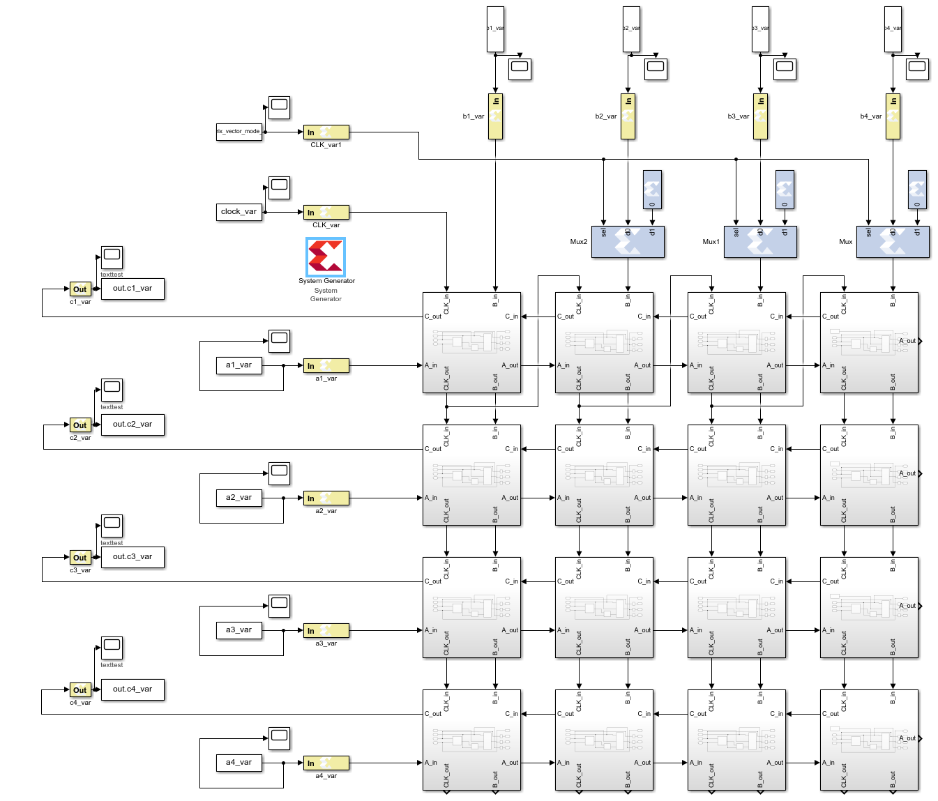
Completed 4x4 Multiplier *Available now with Matrix-Vector mode!!!
16 Multiply-Accumulate blocks are utilized.
Input variables are generated in workspace with correct 0-fill for delays. (A -> rows, B -> columns transposed as rows).
Output variables are streamed to the left into vectors which are concatenated – allows for chaining into another multiplier.
Mux added to B_input of remaining 4 columns to realize Matrix-Vector mode.
Clk_in is forwarding and reset control signal. (every 4 cycles).
Clk_in for successive columns comes from output of preceding columns.
Tested using random numbers (rand(x)).

Slide 5
Visualization of Simple Input/Output
Variable | “Visual” Input | MATLAB Generated
A (Input) | [1, 2, 3, 4] [1, 2, 3, 4] [1, 2, 3, 4] [1, 2, 3, 4] | [1, 2, 3, 4, 0, 0, 0] [0, 1, 2, 3, 4, 0, 0] [0, 0, 1, 2, 3, 4, 0] [0, 0, 0, 1, 2, 3, 4]
B (Input) | [1, 2, 3, 4] [1, 2, 3, 4] [1, 2, 3, 4] [1, 2, 3, 4] | [1, 1, 1, 1, 0, 0, 0] [0, 2, 2, 2, 2, 0, 0] [0, 0, 3, 3, 3, 3, 0] [0, 0, 0, 4, 4, 4, 4]
Clock (Input) | [0, 1, 2, 3, 4, 5, 6, 7, 8, 9, 10, 11, 12] [0, 0, 0, 0, 1, 0, 0, 0, 0, 0, 0, 0, 0] | [0, 1, 2, 3, 4, 5, 6, 7, 8, 9, 10, 11, 12] [0, 0, 0, 0, 1, 0, 0, 0, 0, 0, 0, 0, 0]
C (Output) | [10, 20, 30, 40] [10, 20, 30, 40] [10, 20, 30, 40] [10, 20, 30, 40] | [0, 0, 0, 0, 10, 20, 30, 40, 0, 0, 0] [0, 0, 0, 0, 0, 10, 20, 30, 40, 0, 0] [0, 0, 0, 0, 0, 0, 10, 20, 30, 40, 0] [0, 0, 0, 0, 0, 0, 0, 10, 20, 30, 40]

Slide 6
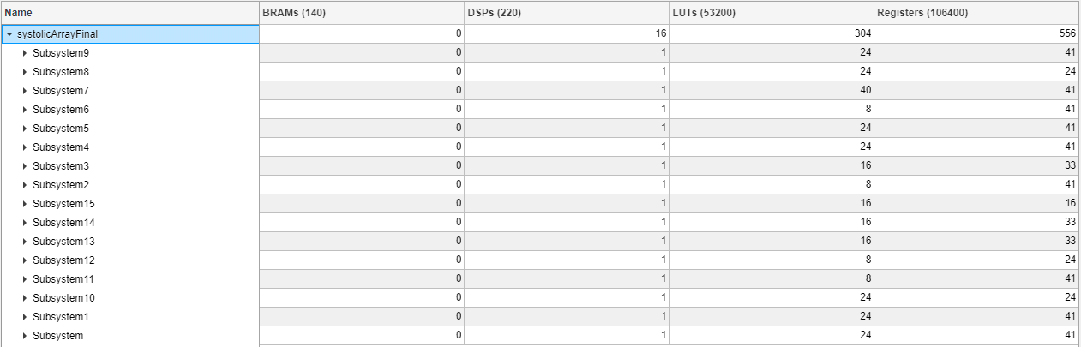
Hardware Cosim Results
Resource Analyzer – 16/220 DSPs, 304/53,200 LUTs, 556/106,400 Registers
Timing Analyzer - PASS

